Slide 1
Comments on social insurance as an unemployment response for New Zealand post-Covid
‘Fixing unemployment: Social insurance and a job guarantee’
Fabian Society Zoom meet-up
Saturday 20 June 2020
Michael Fletcher
Institute for Governance and Policy Studies, Victoria University of Wellington
Institute for Governance
& Policy Studies

Slide 2
Summary
Social insurance (SI) and unemployment insurance (UI) schemes have advantages and disadvantages.
On balance, my view SI is not the best way forward for NZ right now.
First priority is to (re-)establish adequate income support in the core welfare/social assistance (SA) system. SI proposals risk detracting from that.
Even then, many detailed issues to work through. Design is everything in SI schemes. Different designs & parameters produce very different distributional outcomes.
Shifting to a two-tier, SI/SA welfare system would be a major structural change that would take years. It is not a solution to the current pandemic impacts.
Institute for Governance
& Policy Studies

Slide 3
Social insurance and social assistance
Common to distinguish between social insurance (SI) and social assistance (SA) based welfare systems.
New Zealand (like UK and Aust, but not Europe) always based its system on a single-tier SA system (except ACC):
- Aim: poverty protection. - Based on need.
- Tax-funded. - Income-tested.
Supplemented by universal benefits: schools, hospitals, NZ Super, Family Benefit, etc.
Historically, NZ’s system was underpinned by a commitment to full employment (the ‘wage-earners’ welfare state’).
NZ’s SA has been allowed to wither, as has the full employment commitment…
Institute for Governance
& Policy Studies

Slide 4
What is meant by ‘social insurance’?
Most OECD countries have a two-tier, higher SI (or UI)/lower SA system.
Except for the harshest few, all SI-regimes have a SA minimum income protection floor for those who do not qualify for SI or have exhausted coverage. It is the bedrock of poverty protection.
SI is about risk-sharing. SI can handle situations, including uncertainty, that private risk-pooling insurance cannot.
Entitlement can be linked to individual contributions (cf Kiwisaver), or a defined benefit (cf NZ Super). (or variants on these.)
Institute for Governance
& Policy Studies

Slide 5
Social insurance scheme characteristics
SI (and UI) schemes vary immensely. Usually:
Pay percent of prior earnings up to some cap. Often has step-downs as receipt lengthens. Top rates vary across OECD from ~40% to ~90%.
Common to have a minimum prior employment record requirement (eg, ‘24 months in last 36’, etc).
Often compulsory, but sometimes voluntary with other form of State backing/support (eg Denmark).
Payment is time limited (for UI, but may not be for disability), after which recipient falls back to SA support.
The Covid Income Relief Payment is like a UI scheme: fixed-term, requires prior work history, higher than the SA benefit floor, but has a flat rate payment rate, not % of earnings.
Institute for Governance
& Policy Studies

Slide 6
Advantages of SI/UI schemes
Consumption-smoothing in the face of short-term income shocks. Minimises disruption from a sudden drop in income.
Individualised entitlement (cushions income drop for 2-income couples).
Allows longer job-search/better job matching (or transition to re-training).
Depending on design, rules, etc, can offer wide coverage for workers and self-employed.
Can shift funding off general taxation to payroll levies etc ( -> less susceptible to government Budget pressures?)
In some (Nordic) countries schemes are linked to union membership and to collective agreement coverage.
Institute for Governance
& Policy Studies

Slide 7
Disadvantages
Does not address welfare adequacy for those not covered. Need for adequate welfare floor remains.
Unlikely to be as re-distributional as extending/upgrading the status quo. Would do less for poverty protection/reduction.
In NZ, integration with ACC is complex.
If just a UI for job loss risks creating yet another tier (welfare, ACC, & UI).
What about sickness and disability? Covering all income-loss risks is complex and high cost (although, potentially a good long-term objective).
Potentially divisive in terms of public support for welfare (worsen the ‘us and them’ divide not lessen it).
Not like ACC supported because it is a single system for all injured
Some evidence high SI & generous minimum protection go together, but it is weak, and causality is doubtful:
Institute for Governance
& Policy Studies

Slide 8
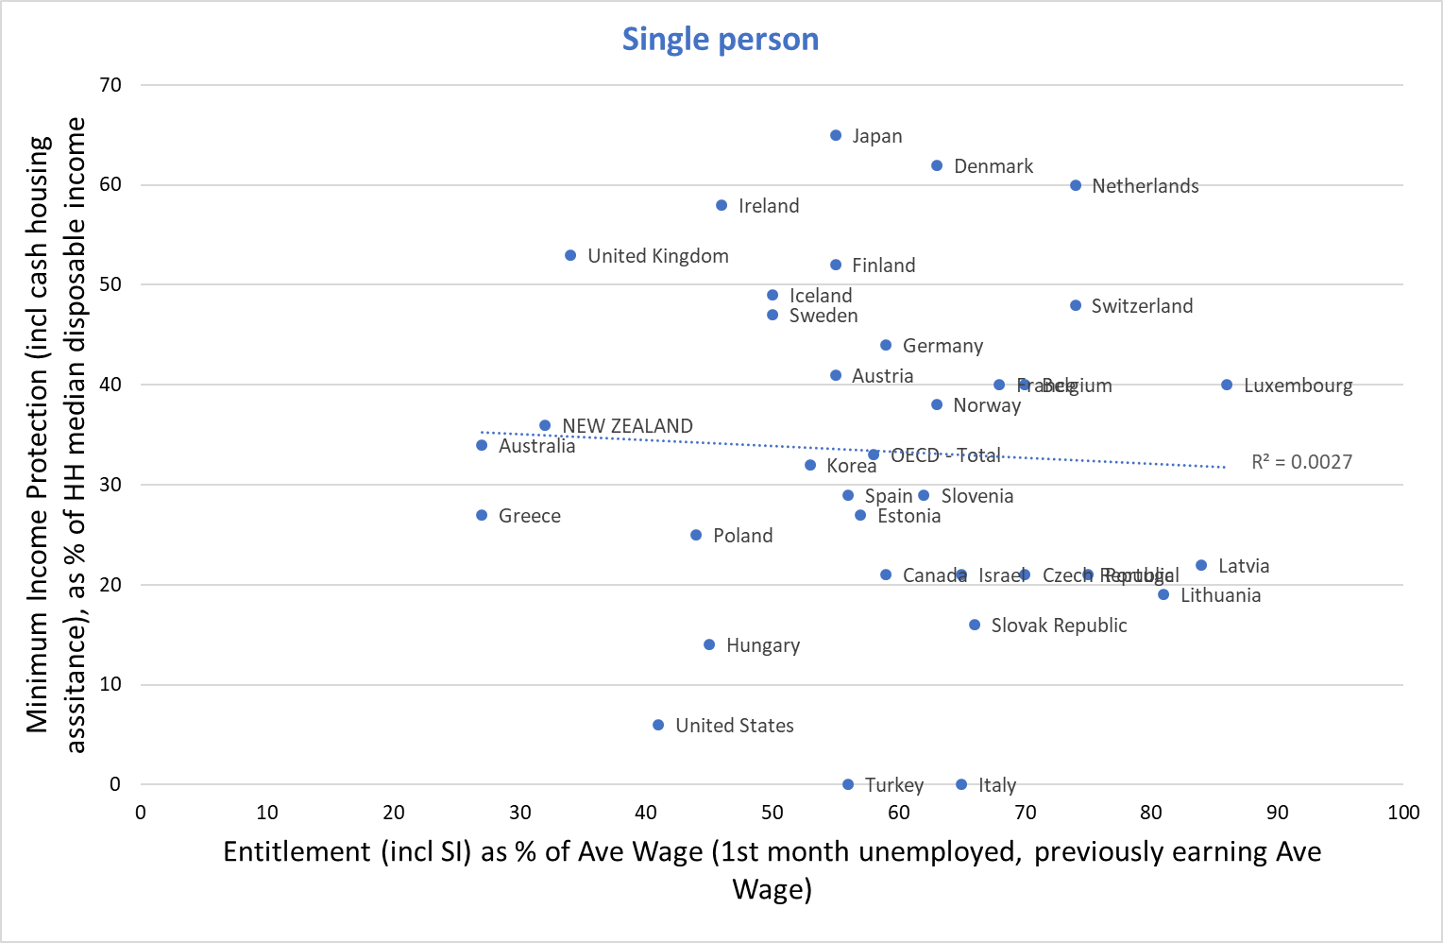
The relationship between SI entitlements and minimum income protection floor is weak across OECD states
[Text]
[Text]
Institute for Governance
& Policy Studies
Source: OECD Social database

Slide 9
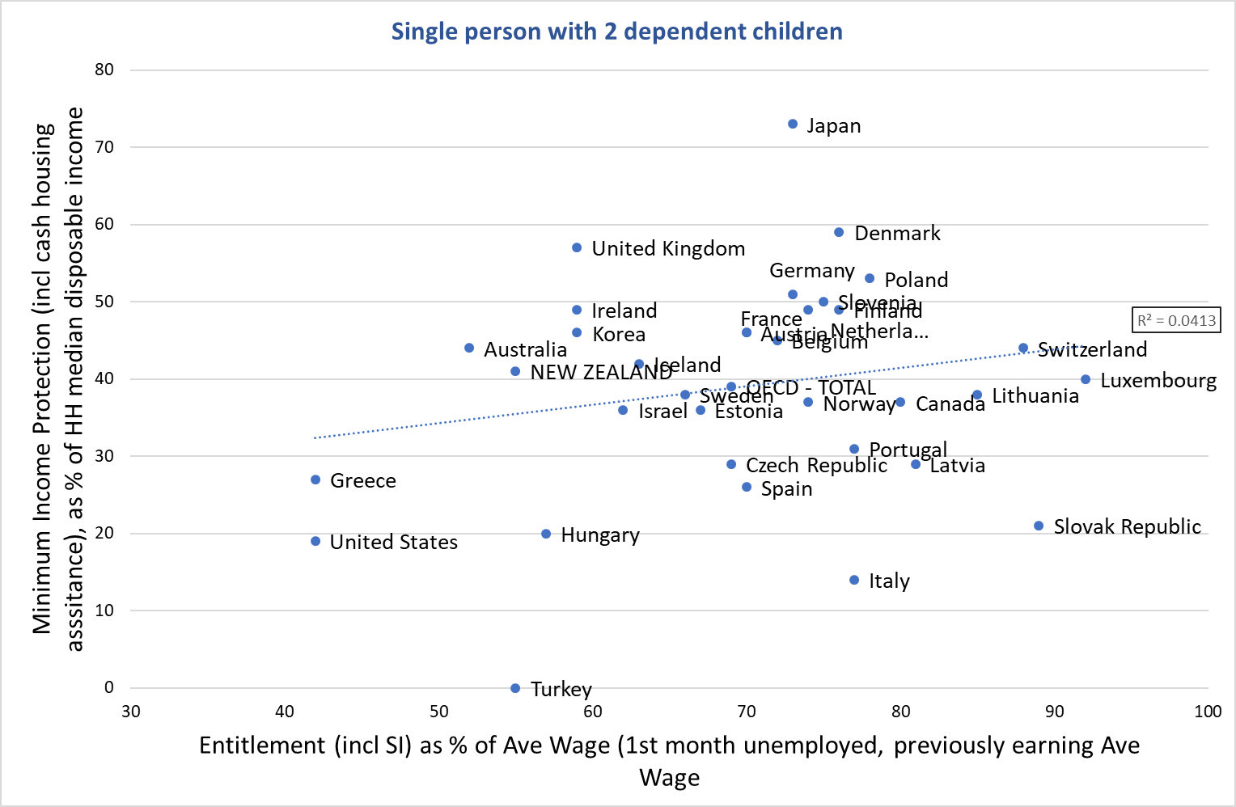
The relationship between SI entitlements and minimum income protection floor is weak across OECD states
[Text]
[Text]
Institute for Governance
& Policy Studies
Source: OECD Social database

Slide 10
Disadvantages (cont’d)
In NZ’s current context, focusing on social or unemployment insurance carries a strong risk of undermining a more inclusive focus on fixing the existing welfare system.
Unlikely (in my view) that the former would lead to the latter
Plus (unless we get a comprehensive JG…), Covid impacts are likely to lead to rising long-term unemployment for some years. SI/UI unlikely to cover long periods out of work.
~~~~~~~~~~~~~~~~~~~
SI/UI and the Jobs Guarantee
Can have both. Say, a short-term UI followed by a JG.
BUT, still need adequate, effective minimum welfare floor for everyone else!
Begs the question: why not simply have the adequate minimum plus JG?
Institute for Governance
& Policy Studies

Slide 11
Possible alternative ways forward
NZ’s welfare structure needs repair, first and foremost.
30 years of decline (less so recently for people with children).
The commitment to full employment needs restoring.
Hasn’t adapted to families’ need for two-incomes (or the growth in separated parenting).
System must work for economy-wide crises and ‘everyday’ individual shocks.
Alternative options can achieve most of the benefits of SI plus poverty protection:
Significantly higher core rates – with less need for add-ons, AS, Hardship grants, etc. Eg, tie adult rate at, say, 40%AWE instead of 25.4%)
(If do want a UI at, say 80% prior earnings, then definitely set single benefit at 40%AWE)
Total revamp of employment services, ALMPs etc – incl a JG. Restore separate Employment Service?
Individualise entitlement. Partially at least, eg: disregard partner’s income up to, at least, AWE.
Could move towards SI by extending ACC – but logical to extend to sickness and disability first. And only after or simultaneous with fixing core welfare.
Institute for Governance
& Policy Studies

Slide 12
Thank you
Institute for Governance
& Policy Studies

